Slide 1
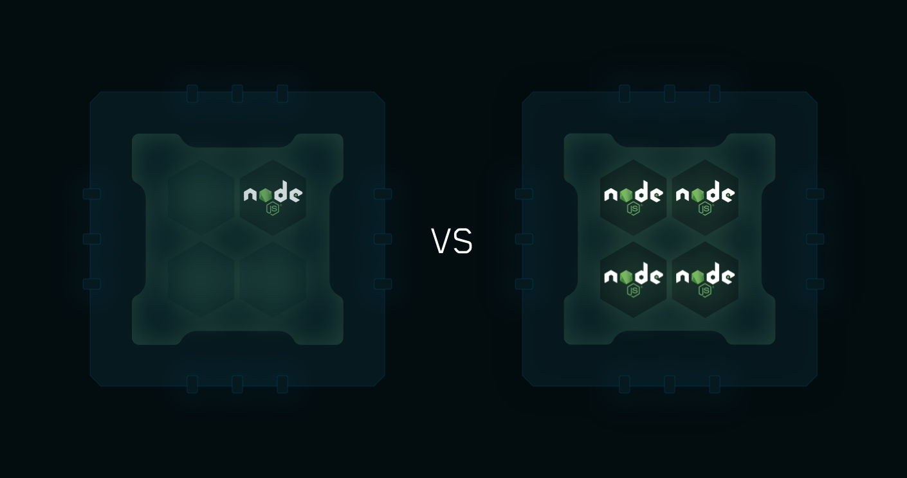
Node JS Cluster

Slide 2
Our Example
child_process Module
Request1
Process - 1
Child Process 1
FabSeries – Worker – 1
Master Process
Request2
Fork()
Request3
Request4
Process - 2
Child Process 2
FabSeries – Worker – 2
Fork()
Request5

Slide 3
Our Example
PM2
Request1
Express App
Instance - 1
Rabbit MQ /
Redis Pub/Sub
Worker - 1
Request2
Request3
Request4
Express App
Instance - 2
Worker - 2
Request5

Slide 4
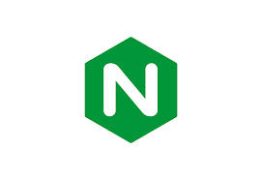
Request1
Nginx Web Server
Request2
Node JS
Application
Request3
Request4
http://localhost
http://localhost:3000
Request5
Request1
Nginx Web Server
Node JS
Application
Request2
Request3
http://localhost:3000
Node JS
Application
Request4
http://localhost
Request5
http://localhost:3001

Slide 5

Welcome
Node JS Cluster with PM2, Rabbit MQ, Redis and Nginx
Pravinkumar R .D.

